Slide 1
Time Series Modeling for Predictive Maintenance
Samuel Scovronski
April. 7th, 2022

Slide 2
Problem Statement
Companies and Customers want to minimize the cost of ownership while maximizing the life of their products
Current method to address those needs is a prescribed preventive maintenance schedule which results in an unoptimized solution
If scheduled too frequently then the cost of ownership is not minimized
If scheduled too infrequently then a failure could occur resulting in a lower product life
Can we reliably predict when a failure will occur with sufficient time for an intervention?

Slide 3


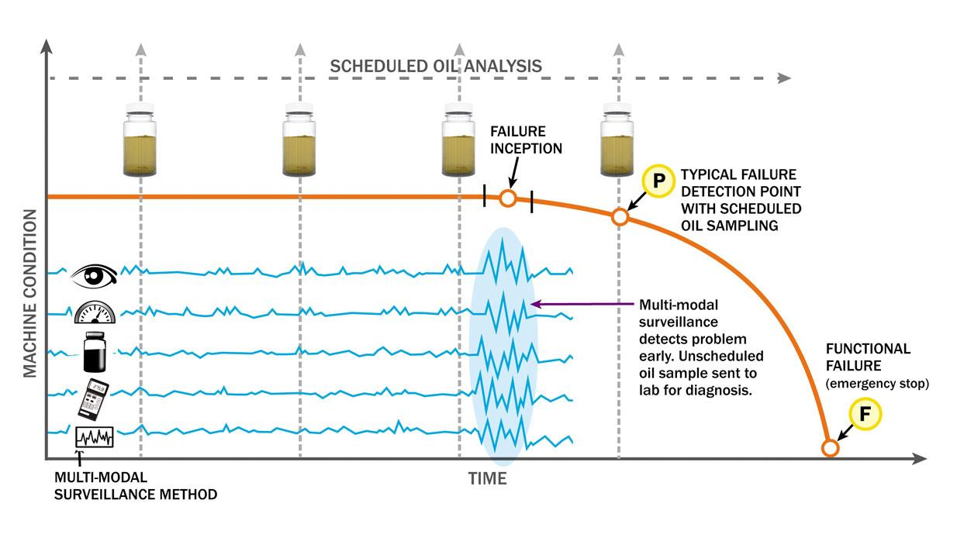
Why is it important?
Minimize unplanned downtime
Minimize maintenance costs
Sell replacements before failure

Slide 4


Data Source
Kaggle: Microsoft Azure Predictive Maintenance
Telemetry data collected hourly over a year for 100 machines
Includes failure, maintenance, and error logs for the machines
Telemetry data consists of readings from four sensors: Vibration, Rotation, Voltage, and Pressure
Unbalanced classes with 876,000 rows of data, and only 700 rows with failures

Slide 5



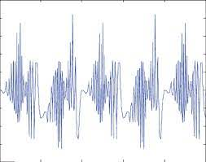
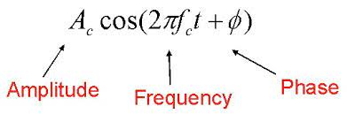
Data Exploration
Machine age makes no difference
Data spikes
Synthetic data

Slide 6
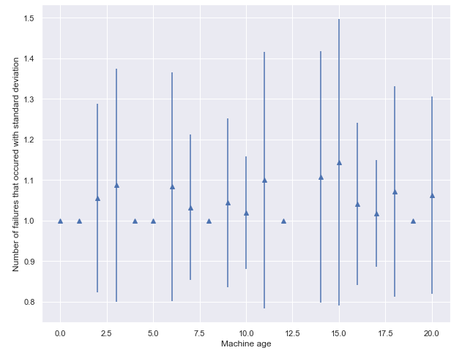
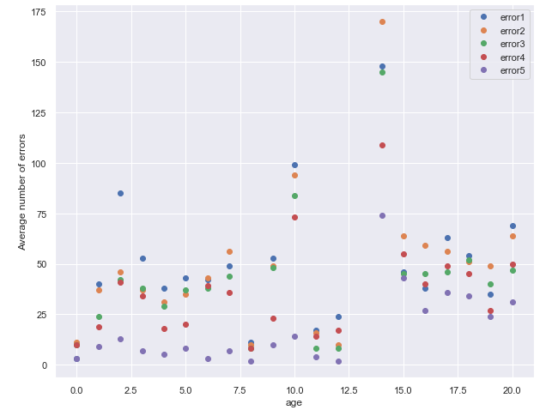
Machine Age Does Not Impact Performance
Older machines do not experience more failures
Machines experience 0.3% more errors in general per year of usage

Slide 7
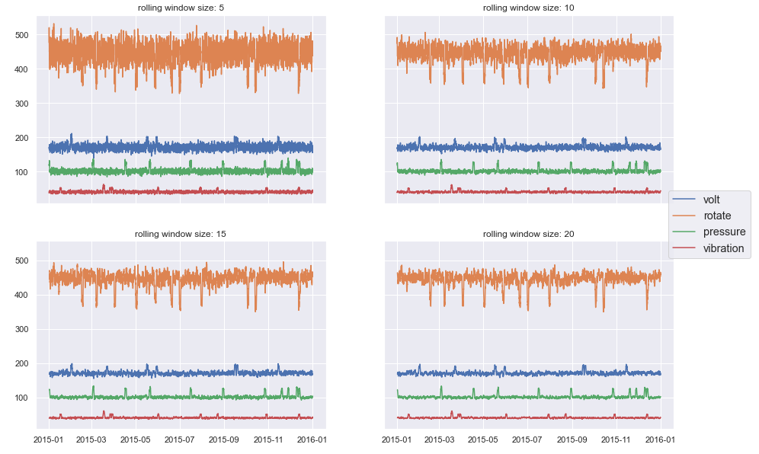
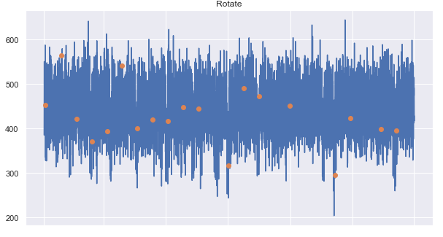
Sensor Anomalies & Failure Prediction
The moving average shows deviations from typical operations
The failures that occur occasionally overlap with the deviations

Slide 8
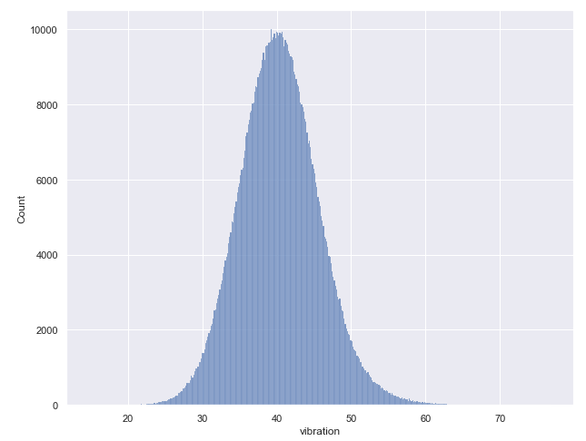
Synthetic or Measured Data?
The data owner did not state if the data was generated or collected from machines
Although there is no way to conclusively test if the data was generated, based on the distribution the data seems like it was generated because it is almost perfectly normally distributed

Slide 9
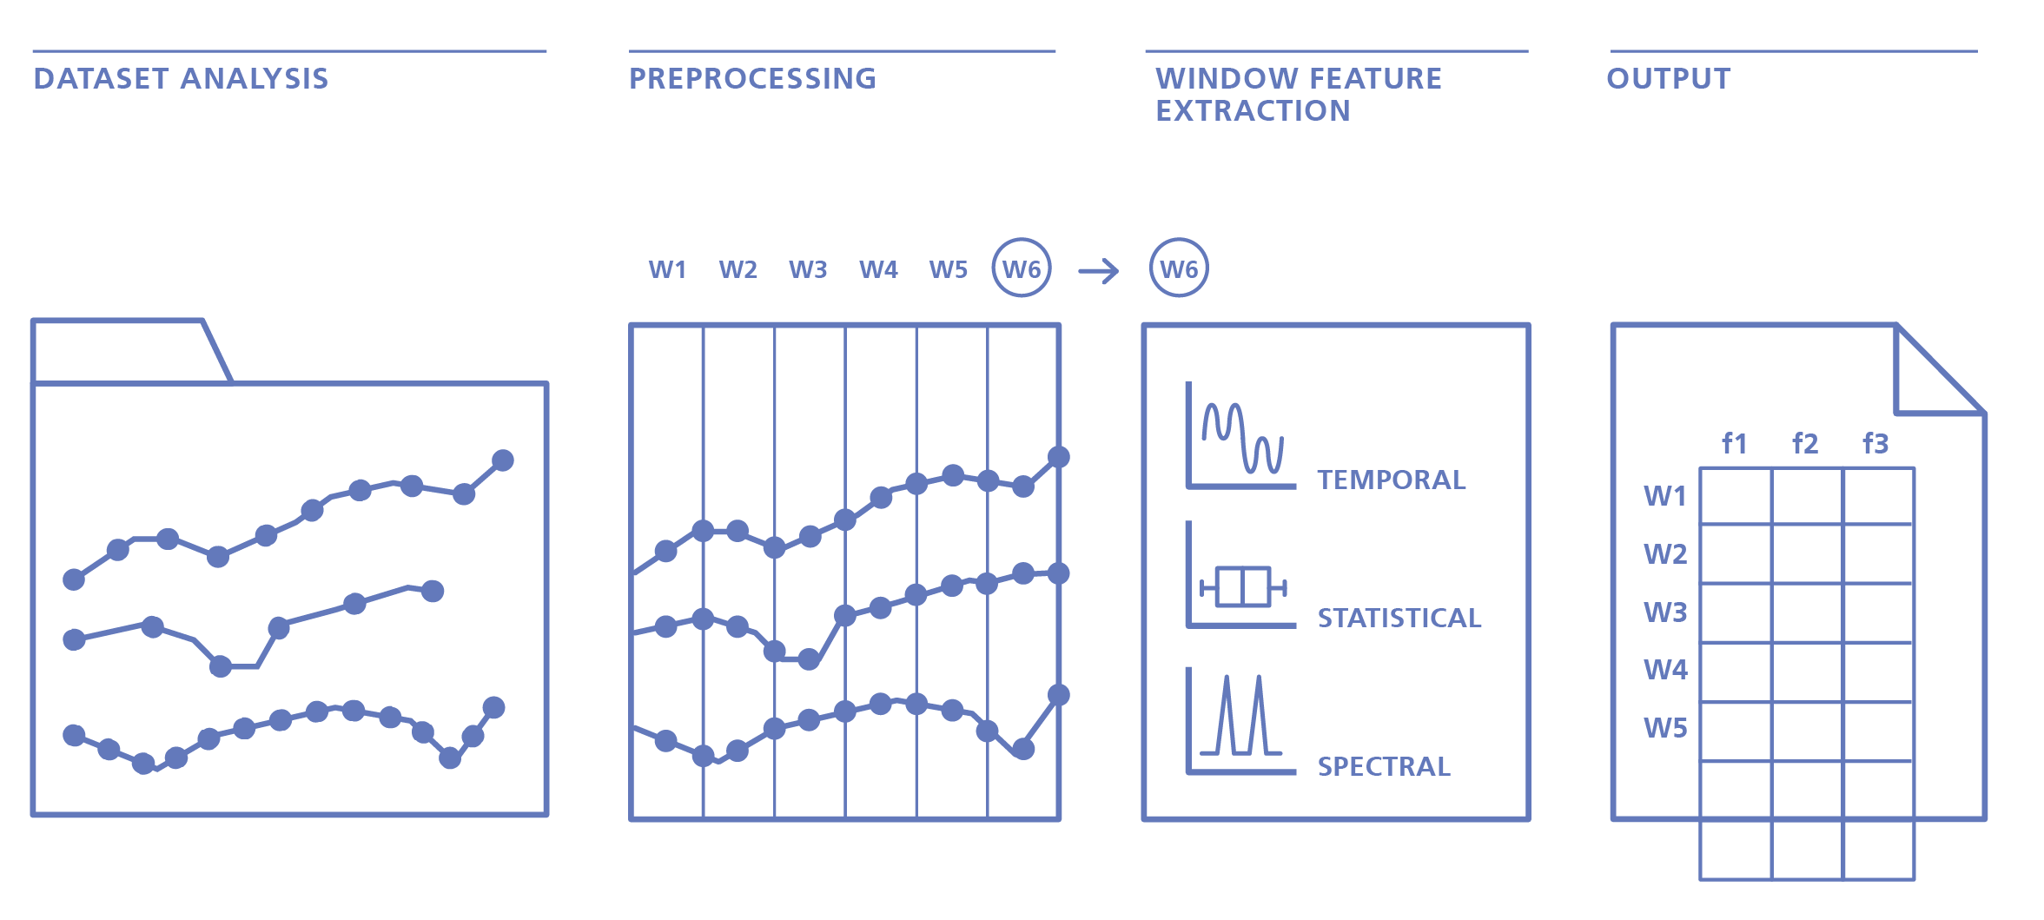
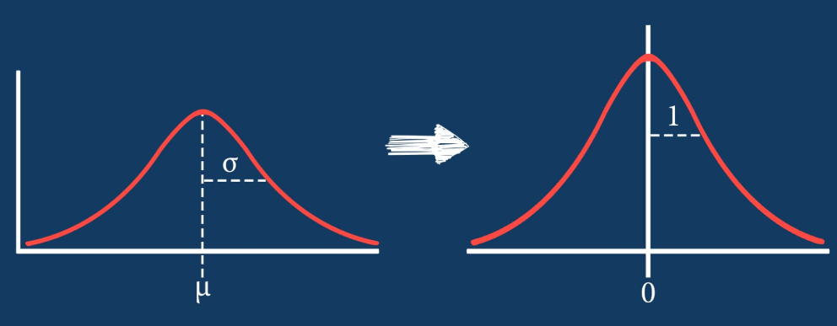
Data Preparation
1. Windowing Data and Feature Extraction
The data series was grouped into time windows
Window size was held constant and was advanced one time step between groups
Statistical values were calculated on each window
2. Standardization
Mean of 0 and standard deviation of 1
minimize the impact on feature importance
3. Target Value
Predicting failure 5 timesteps in the future
Need to offset the failure timestamp

Slide 10
Evaluation Criteria & Baseline Model
Predict every failure that will occur →
maximize recall
Minimize nuisance tripping →
maximize precision
These goals can be combined into a single value →
maximize f1 score
A model that always predicts failure would have 100% recall, but 0% precision resulting in an f1 score of 0
A random guessing model would have a recall of 50%, and precision of 0.08% resulting in an f1 score of 0.0016 on average

Slide 11
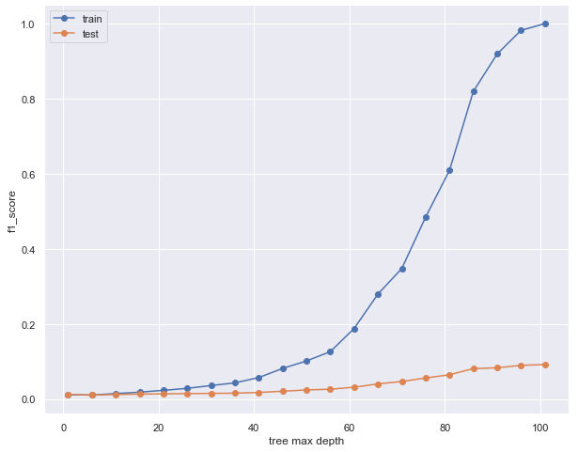
Model Selection
All models used a weighted error during fitting due to the data imbalance
Conclusion: Decision Tree model performed the best when the training data was overfitted
Model Type | F1 Score
Decision Tree | .0884
Random Forest | .0524
Logistic Regression | .0067
Linear SVC | .0000
Although much better performance than the baseline model, still far from useful

Slide 12
Oversampling
In an attempt to increase the score can use more complex models like a Neural Net, but they do not allow error weighting to compensate for the class imbalance
Used the SMOTE method for oversampling
Critical to split the data before oversampling or else risk contamination of information of training data in the other data sets
Model Results: SMOTE before splitting
Model Results: SMOTE after splitting
Dataset | Precision | Recall | F1 Score | Accuracy
Train | .99 | 1.0 | 1.0 | 1.0
Validation | .99 | 1.0 | .99 | .99
Dataset | Precision | Recall | F1 Score | Accuracy
Train | .99 | 1.0 | 1.0 | 1.0
Validation | .97 | .21 | .35 | .60

Slide 13
Model Refinement
Data split into a training, testing, and validation set
Testing set used to prevent overfitting while the model was being trained
One hidden layer with 50 nodes
Dataset | Precision | Recall | F1 Score | Accuracy
Test | .94 | .83 | .88 | .89
Validation | .94 | .86 | .90 | .90

Slide 14
Future Work
Create a tradeoff curve between the f1 score and the prediction horizon by creating multiple models
Combine these models to give a probability of failure within X amount of time

